Slide 1
Vectors
Week2

Slide 3
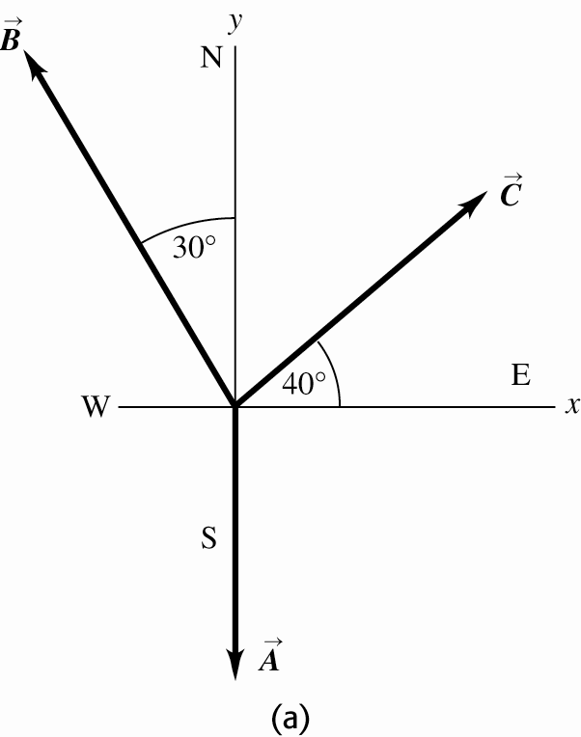
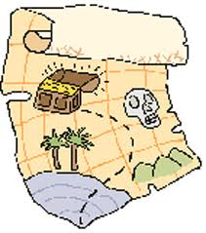
1. Find the position of treasure. While following a treasure map, you start at an old oak tree. You first walk 825 m directly south, then turn and walk 1.25 km at 30.0˚ west of north, and finally walk 1.00 km at 40.0˚ north of east.

Slide 4
Given two vectors
a) Find the magnitude of each vector.
b) Calculate A – B
c) If C = A – B Find the magnitude of C. Is this the same as the magnitude of B-A
B-A = -A-B so A-B and B-A have the same magnitude but opposite directions.

Slide 5
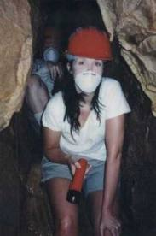
1.33 A spelunker is surveying a cave. She follows a passage 180 m straight West, then 210 m in a direction 45 ° East of South, and then 280 m at 30° east of North. After a forth unmeasured displacement, she finds herself back where she started. Determine the magnitude and displacement of the fourth displacement.
30°
280
180
210
45°
So vector to return to start would be the negative of this 143 m is a direction 41° South of West

Slide 6
3. Knowing the scalar product for two vectors is
.
a) calculate the scalar product for the two vectors
b) Using the scalar product, find the angle between the two vectors

